Slide 1
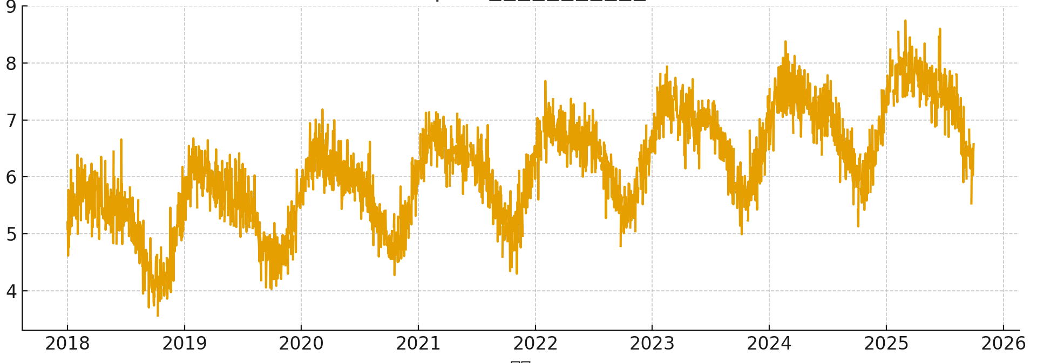
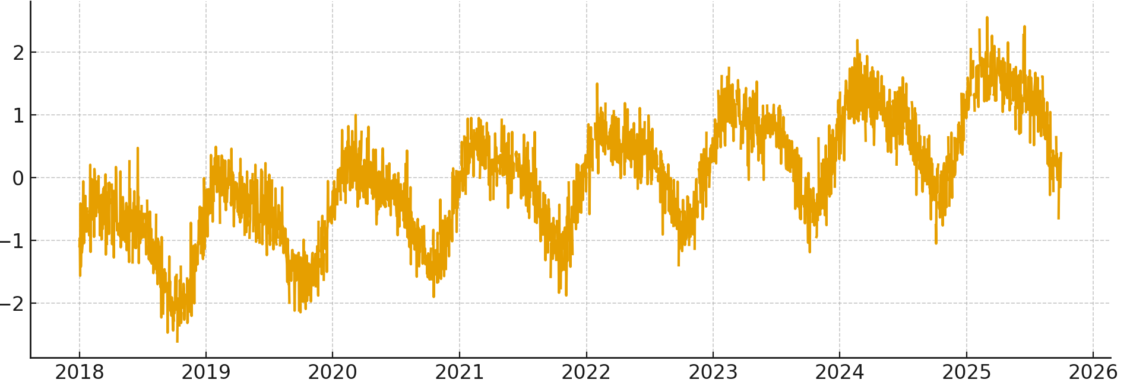
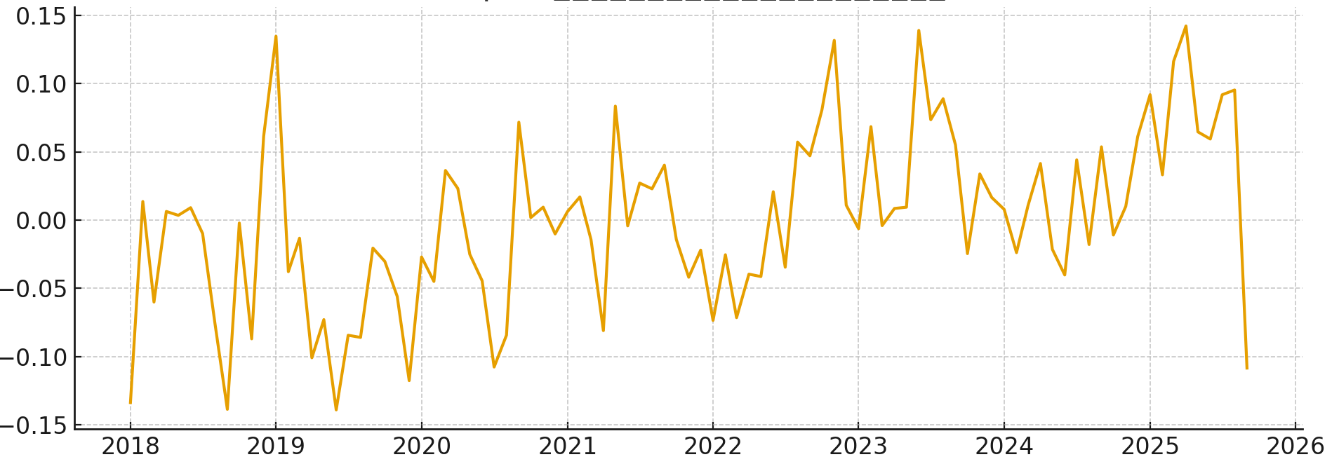
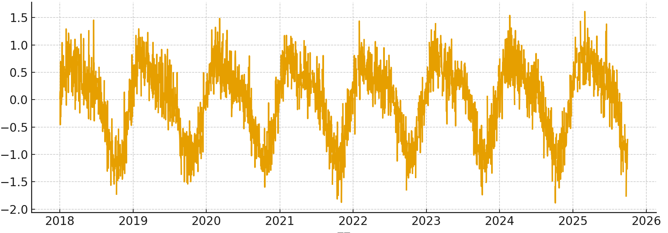
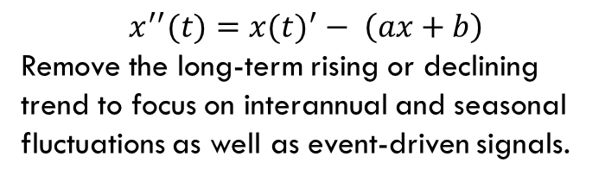
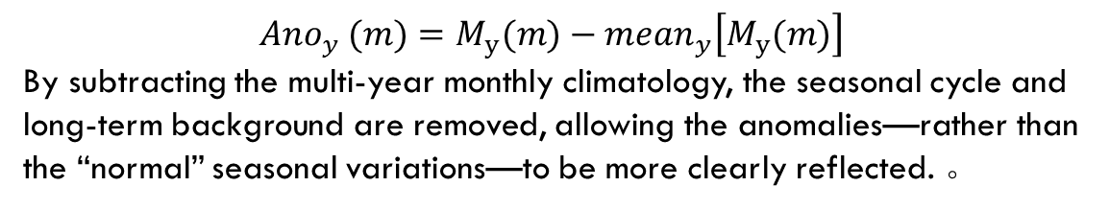
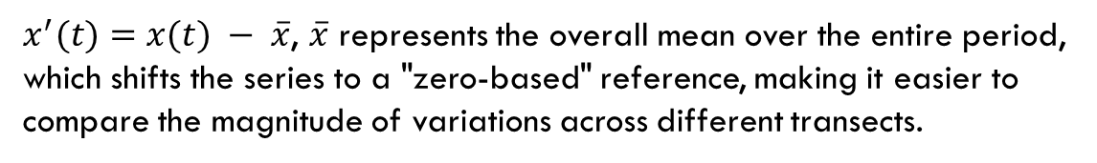
Remove long-term mean, Detrend, Monthly mean anomalies
$x^{′}(t)=x(t) − \overline{x}$, $\overline{x}$ represents the overall mean over the entire period, which shifts the series to a "zero-based" reference, making it easier to compare the magnitude of variations across different transects.
$$x^{′′}(t)={x(t)}^{′}− \left(ax+b\right)$$
Remove the long-term rising or declining trend to focus on interannual and seasonal fluctuations as well as event-driven signals.
$${Ano}_{y} (m)=M_{y}(m)−{mean}_{y}\left[M_{y}(m)\right]$$
By subtracting the multi-year monthly climatology, the seasonal cycle and long-term background are removed, allowing the anomalies—rather than the “normal” seasonal variations—to be more clearly reflected. 。

Slide 2
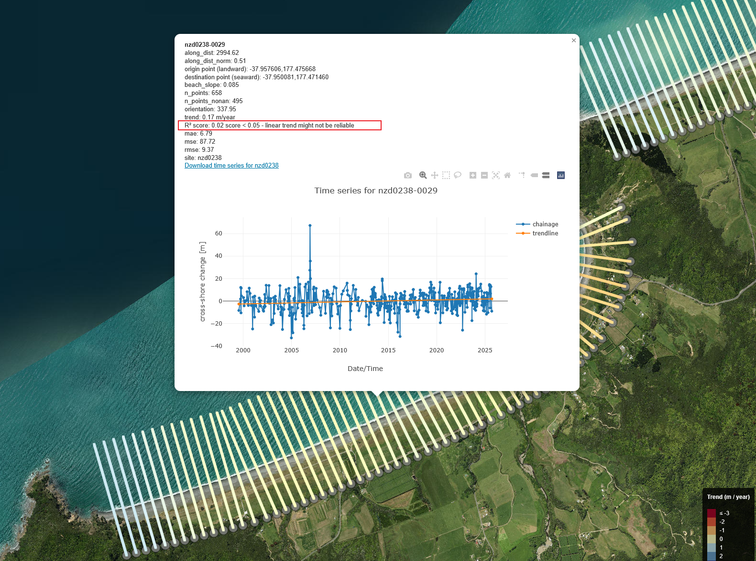
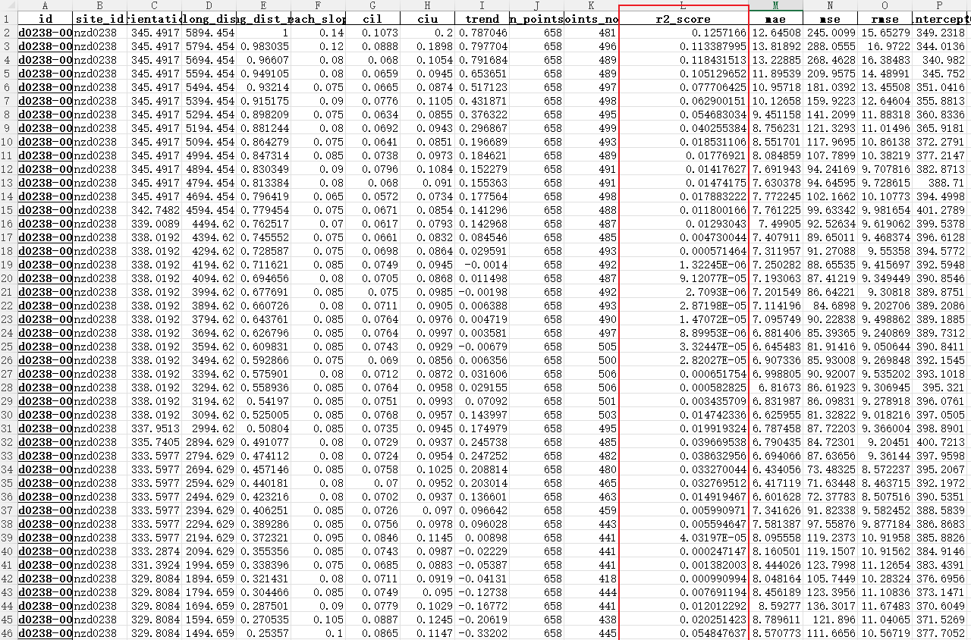
Significant data: Trend
Before detrending the selected coastlines, transects with an R² score greater than 0.05 were filtered to ensure the reliability of the processed data. The average variation of these filtered transects was then used to represent the overall coastline change.

Slide 3
The improvement after process

Slide 4
The improvement after process

Slide 5
Smooth parameter S influence

Slide 6
Smooth parameter S influence

Slide 7
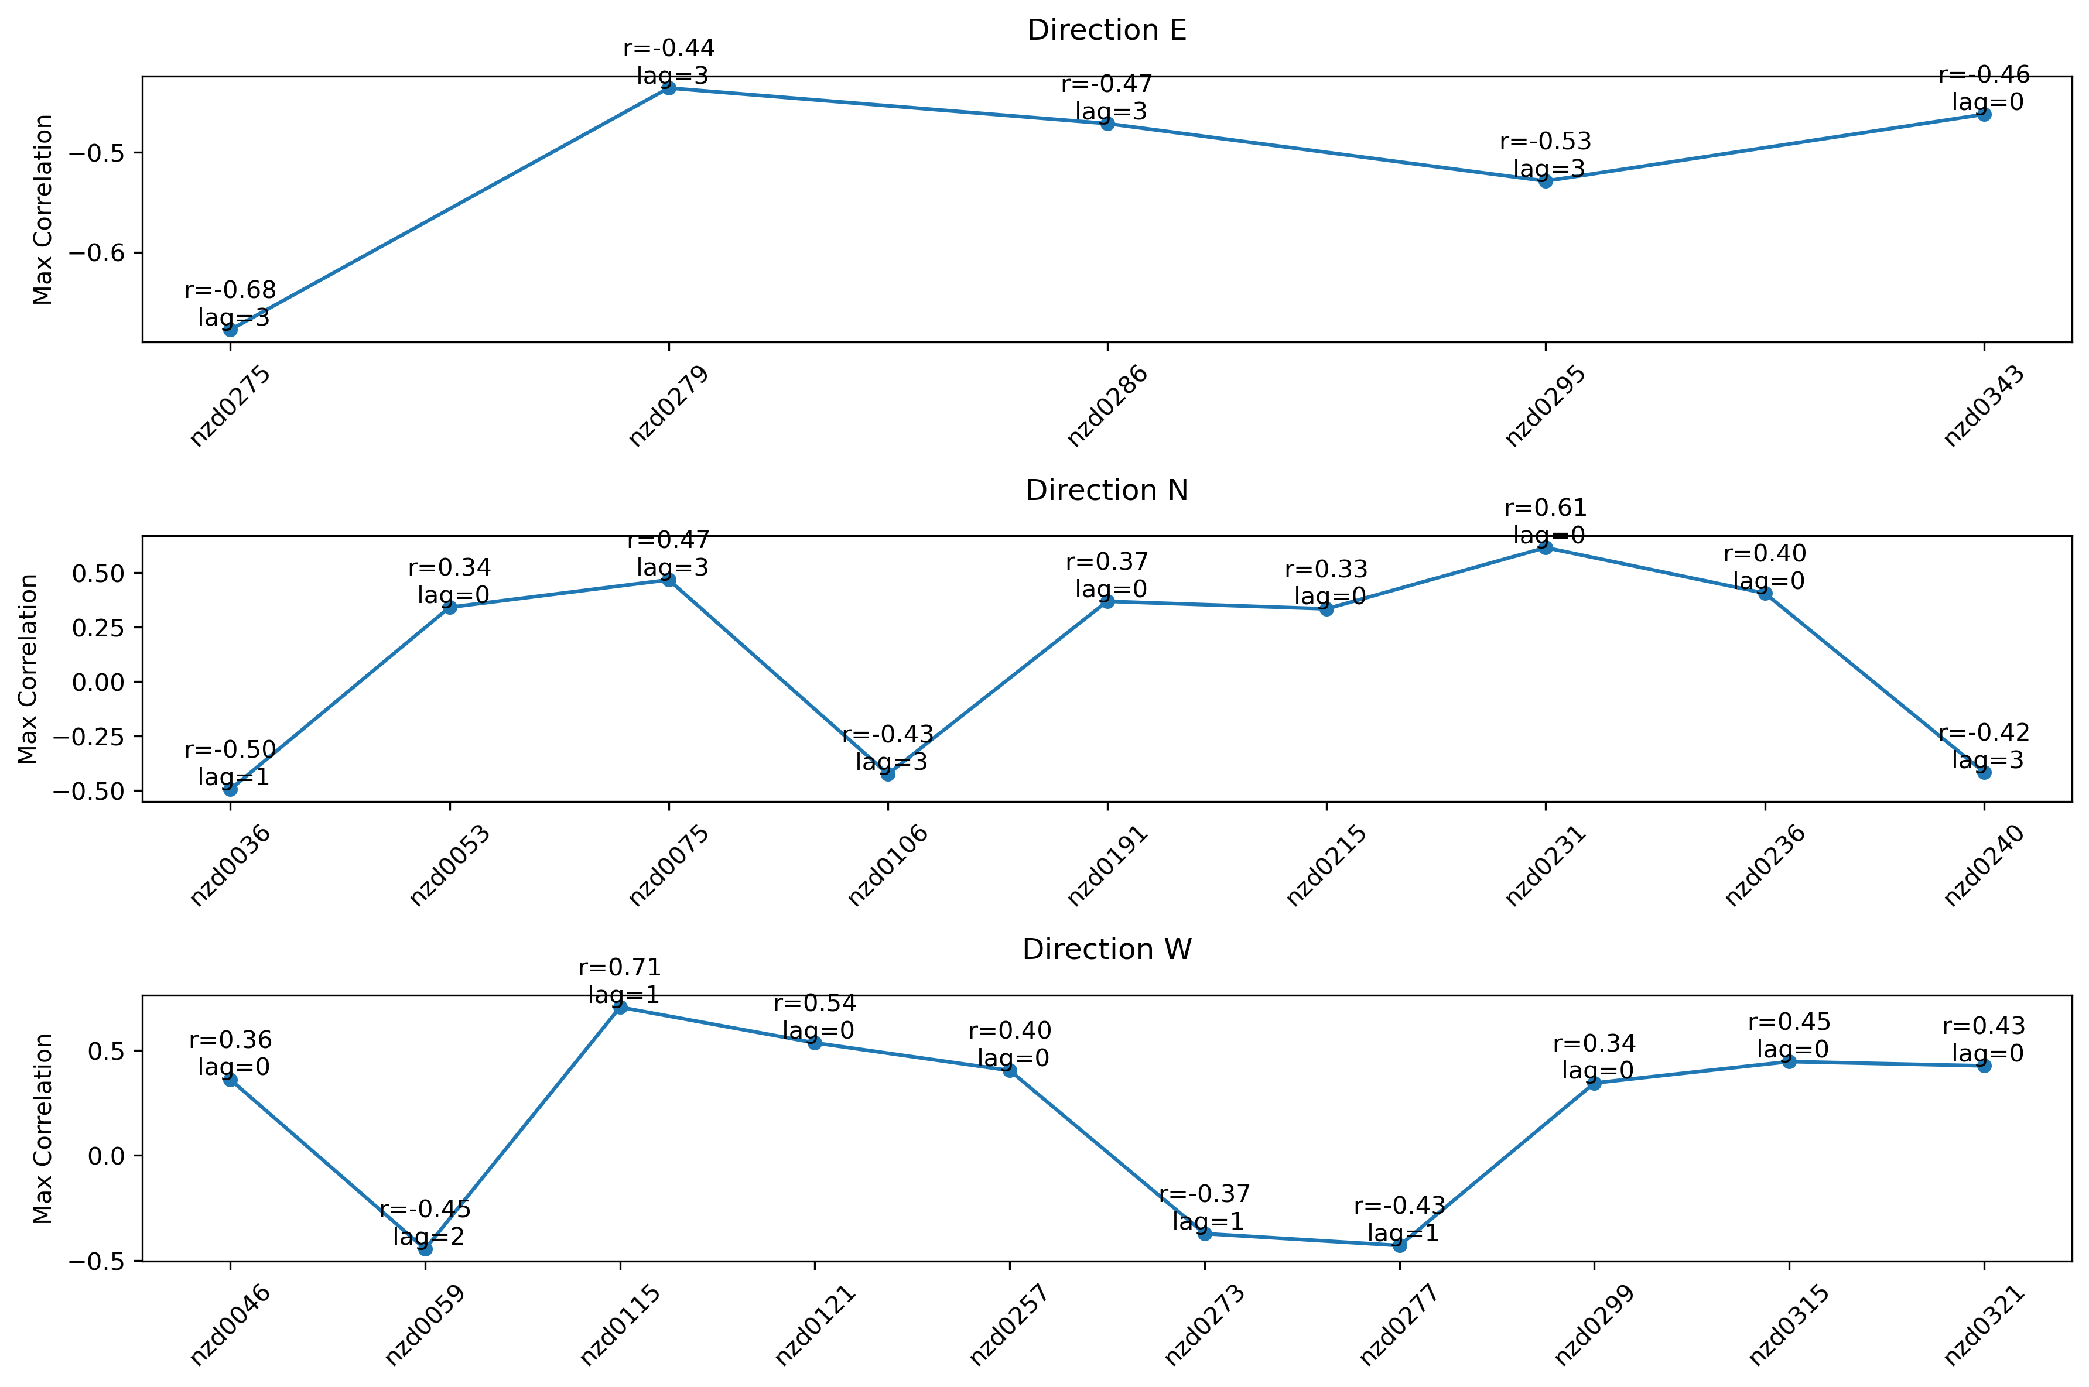
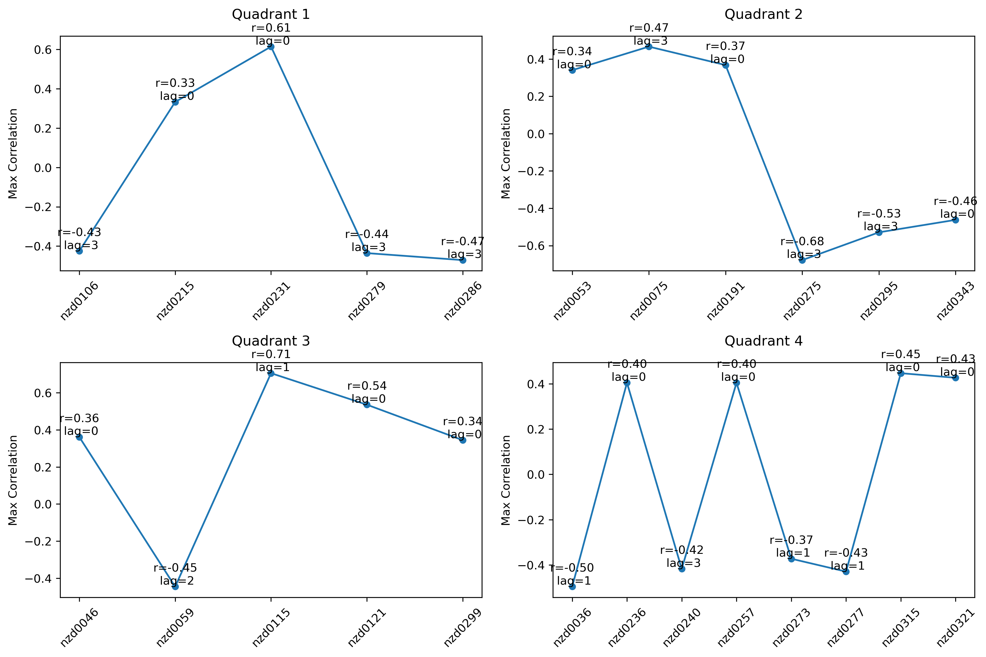
2010-2014

Slide 8
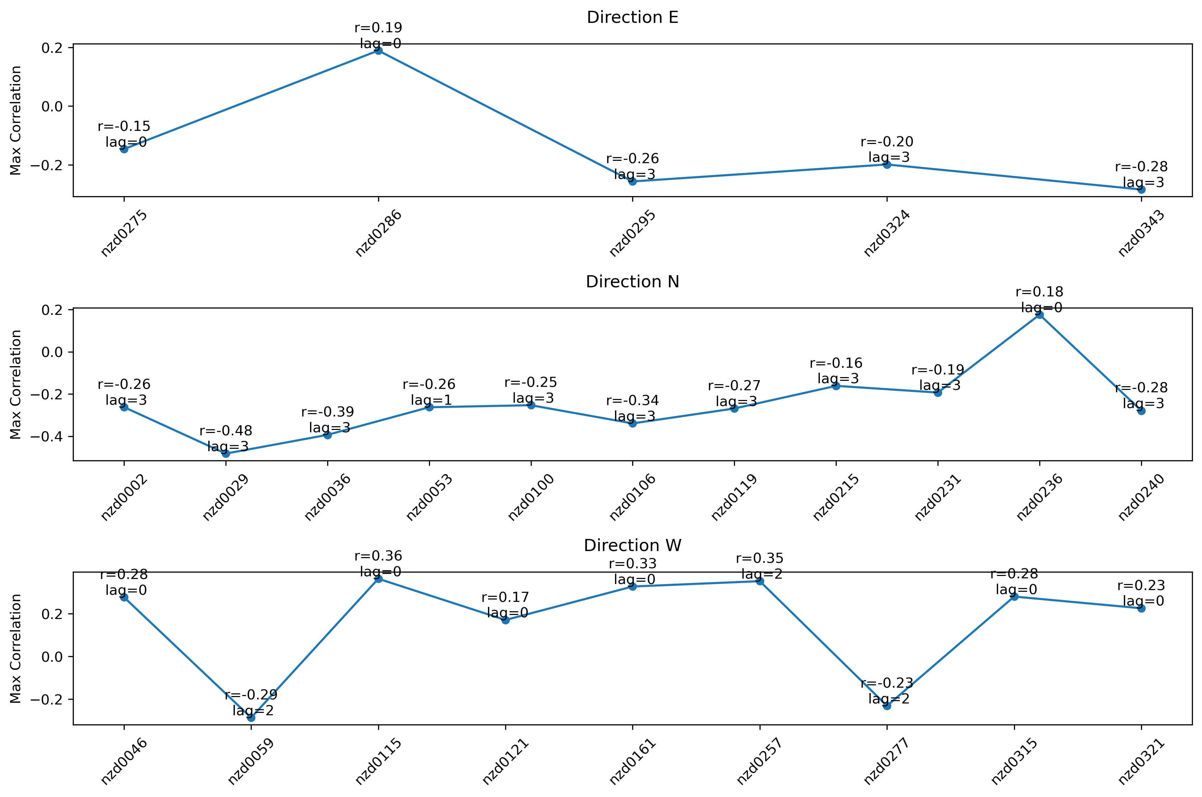
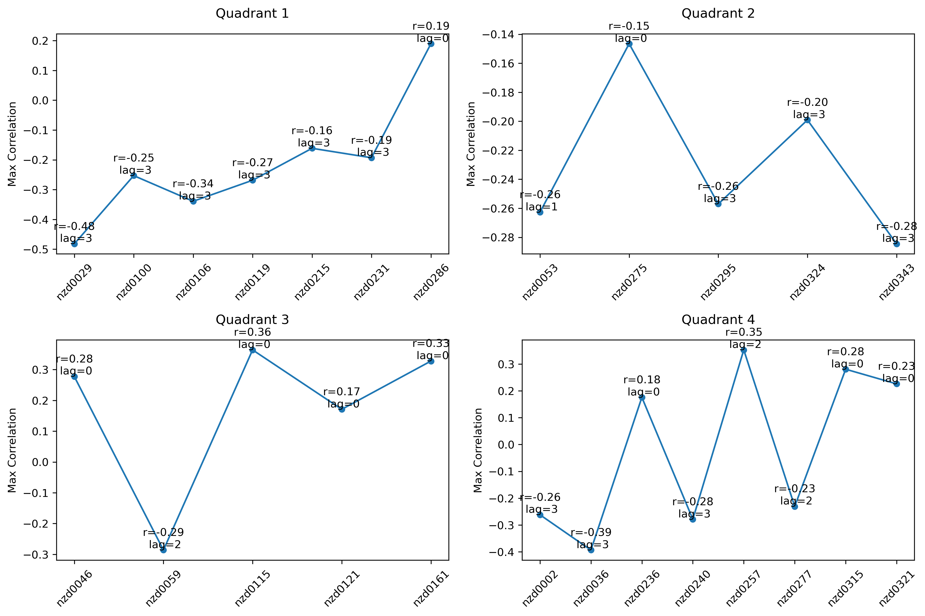
1999-2024

Slide 9
Question
Wavelet coherence
Systematically compare results with vs without seasonal-cycle removal and recommend a preprocessing choice.
add more climate indices (iod, zw3, sam, etc.) And apply unsupervised learning to explore the relationships among them.

